Slide 1
May 2018 Council Meeting
5/23/2018

Slide 2
Agenda
Thank-A-Thon at 6 p.m.
Part II on Thursday
Business meeting opening
Announcement of Election Results
Discussion of process and take-a-ways for next year
Awards
Announcement of Alum of the Year
Announcement of Young Alum of the Year
Awards Ceremony Plans
Glass House Trip Recap
Upcoming Events
Annual Fund Update
MOA Update
501c3 Update
New Business
Thank you to those who served CUAA

Slide 3
CUAA Spring 2018 Election Results
Alumni Trustee
Christina Aguirre-Ross, AR ’81 367 Dr. Lyn Pentecost, A ’70 315
Secretary
Mary K. Lynch ChE '82 696
Treasurer
Stephen Verderese, EE ‘84 683
Vice President Faculty-Student Liaison
Margaret Matz, AR ‘83 672
Vice President of Events
Kelly Occhiuzzo Zack A’90 369 Hope Wade, A ’87 303
Nominating Committee Chair
Kay Nordstrom, ME ‘77 433
Teller Committee Members
Athena DeNivo CE’94 (Chair), Al Brand CE’67, Joanne Pesce CE’94, David Gennings ME ‘95, Aleksandr Krutovskiy CE’99, Matthew Ruehle CE’07 and Rose Carla Guerrier CE’14

Slide 4
CUAA Spring 2018 Election Results
Alumni Council
Claudia F. Giordano, A 1976
Caitlin (Katie) Correll, ME 2012
Beatriz Ponce, ME 2011
Lily Zand, AR 1988
Daniel P. Burke, Esq., ChE 1981
Lawrence (Larry) Levine, AR 1969
Dr. James Haywood Rolling, Jr., A 1988
Shankar Venkataraman, BSE 2003
Sabeel Yosef, CE 2005
Jennifer Collins, A 1993
Bernard (Bernie) Codd, ChE 1983
Mark O'Grady, A 1976
Alternates
Anthony Manganiello, CE 2006
Standish Lee, AR 2011
Westley Rozen, AR 2005
Genevieve Martin, A 2011
Christopher Panebianco, ChE 2016
Brendan Butler, EE 2007
Justin Richter, ChE 2016

Slide 5
CUAA Spring 2018 Election Results
Nominating Committee
Kay Nordstrom, ME 1977 (Chair)
Susan Shaw, A 1972
Darrell Low, EE 1989
Laura Spinner, A 1989
James Liubicich, ChE 1983
Elizabeth Graziolo, AR 1995
Stephen Vederese, EE 1984
Daniel P. Burke, Esq., ChE 1981
Tim Lim, CE 2012
Scott Lyne, ChE 1992
Alternates
Shankar Venkataraman, BSE 2003
Curtis B. Wayne, AR 1975
Anthony Manganiello, CE 2006
Nick Vargas, CE 2006
Dennis Kong, IDE 2008

Slide 6
CUAA Spring 2018 Election Results
Nominating Committee
Kay Nordstrom, ME 1977 (Chair)
Susan Shaw, A 1972
Darrell Low, EE 1989
Laura Spinner, A 1989
James Liubicich, ChE 1983
Elizabeth Graziolo, AR 1995
Stephen Vederese, EE 1984
Daniel P. Burke, Esq., ChE 1981
Tim Lim, CE 2012
Scott Lyne, ChE 1992
Alternates
Shankar Venkataraman, BSE 2003
Curtis B. Wayne, AR 1975
Anthony Manganiello, CE 2006
Nick Vargas, CE 2006
Dennis Kong, IDE 2008

Slide 7
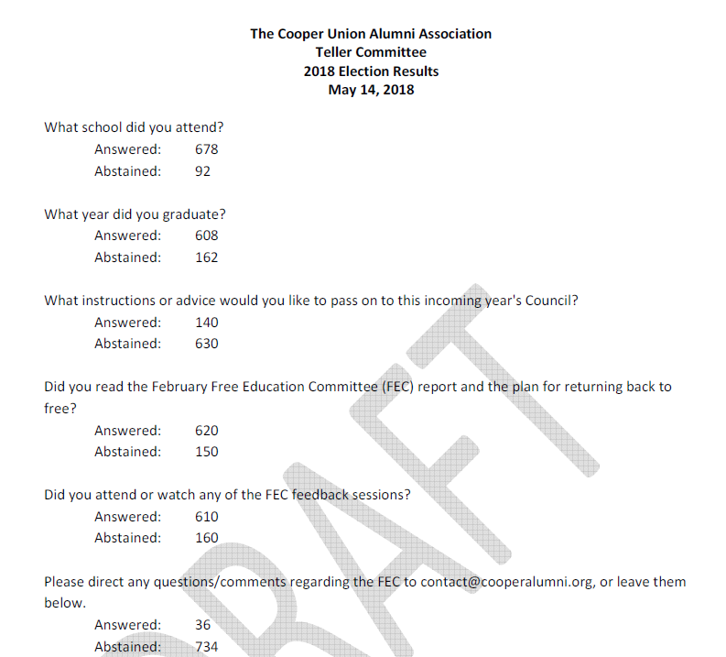
CUAA Spring 2018 Election Results
770 Total Votes
Alumni Electronic: 768
Student Electronic: 2
More than 100 voters provided feedback

Slide 8
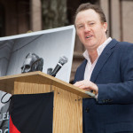
Alumnus of the Year
Nils Folke Anderson A’94
CUAA President 2015 – 2017
Chair of MOA Committee
Chair of 1859 Committee

Slide 9
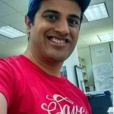
Young Alumnus of the Year
Shankar Venkataraman BSE’03
CUAA Council Member 2015-2018
Chair of Election Committee
Organizer of Meet the Candidate nNghts
Member ,of Get-out-the vote and Nominating Committee
Helps with meetings, phone-a-thons and alumni engagement

Slide 10
Awards Ceremony Plans

Slide 11
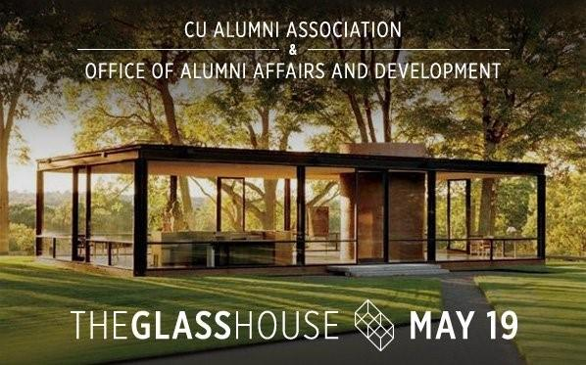
Glass House Trip Recap

Slide 12
Upcoming Events
Thankathon, Part II
May 24, 2018
End of Year Show Alumni Get Together at McSorley's
May 22, 2018
Reunion Weekend
June 1-3, 2018
Hall of Fame Award Presentations
June 1, 2018

Slide 13
Annual Fund Update
Current total: $2,500,384
Up 16% from this time last year)
Alumni total: $1,818,148
Up 18% from this time last year)
Total Alumni donors: 2,365
Up 3% from this time last year)
Average Alumni gift: $769
Up 14% from this time last year)
Increased Importance of Fundraising
The approved plan to return to full tuition scholarships calls for an increase in current-use fundraising by an average of $1.2 million (or 25%) annually over the next five years and by an average of 11% annually for the next five years thereafter.
Increased current-use fundraising accounts for over 50% of the financial initiatives that comprise the FEC plan to return to free

Slide 14
501(c)(3) Update

Slide 15
New Business

Slide 16
Thank You to Those Completing Terms
Treasurer
Ciera Lowe ChE ’14
Vice President/Faculty and Student Liaison
Daren Rogers AR ’05
Council Members
Ed Abaid CE’76
Gene Tulchin A’55
Ira Silfin ME’85
Paul Garrin A’82
Susan Shaw A’72
Westley Rozen AR’05
Kathryn Berry AR’80
Bhaskar Krishnamachari EE’98

